Slide 1


Sets and SQL
CSCi 232
Alvin Lam

Slide 2
Sets
Set – arbitrary collection of items (called elements)
x ∈ S (denotes membership)
x is some element
∈ denotes "element of"
S is some Set
In laymen's terms, the above states that a element x is a element of some set S
We can think of tables as being sets and rows being the elements in a set
A | B | D
1 | 2 | 4
1 | 6 | 3

Slide 3
Set Operations
When talking about sets we usually have 3 go to operations
Union – Denoted by the symbol ∪
Intersection – Denoted by ∩
Difference – Denoted by –
Assume the following sets
A = {1,2,3}
B = {2,3,4}
A ∪ B = {1,2,3,4} (The elements that appear in either A or B)
A ∩ B = {2,3} (The common elements between the sets A and B)
A – B = {1} (All elements in set A that are not found in set B)

Slide 4
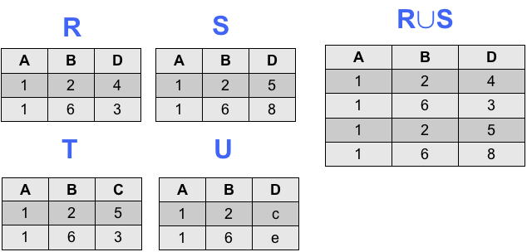
Union
In SQL, two tables are union compatible if and only if they have the same number of column and corresponding domains(types).
The union of 2 or more tables will generate a single table.
Given the following union-compatible tables R and S,
R ∪ S = all rows in either or both R and S
Practice: What is T ∪ U?

Slide 5
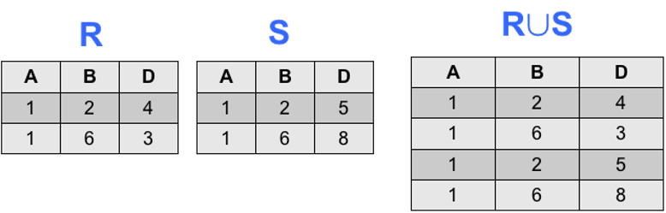
Union Syntax
Keyword: UNION
Syntax:
SELECT <attributes> FROM <table> […]
UNION [ALL]
SELECT <attributes> FROM <table> […]
The keyword ALL to the right of UNION will retain any duplicate rows
Example:
SELECT A,B,D FROM R
UNION ALL
SELECT A,B,D FROM S

Slide 6
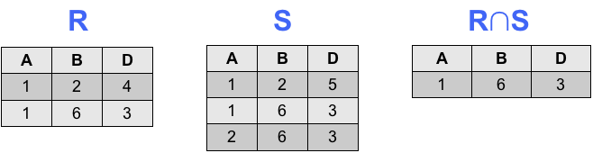
Intersection
Given union-compatible tables R and S
R ∩ S = All rows in both R and S
The Intersection of 2 or more tables will generate a single table.

Slide 7
Intersection Syntax
Keyword: Intersection
Syntax:
SELECT <attributes> FROM <table> […]
INTERSECT
SELECT <attributes> FROM <table> […]
Example:
SELECT A,B,D FROM R
INTERSECT
SELECT A,B,D FROM S

Slide 8
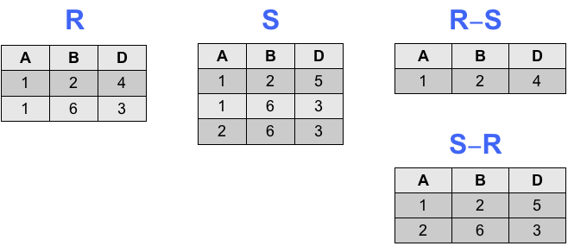
Difference
Given union-compatible tables R and S
R – S = All rows in R minus any overlapped rows with S
S – R = All rows in S minus any overlapped rows with R
The Intersection of 2 or more tables will generate a single table.

Slide 9
Difference Syntax
Keyword: EXCEPT
Syntax:
SELECT <attributes> FROM <table> […]
EXCEPT
SELECT <attributes> FROM <table> […]
Examples:
SELECT A,B,D FROM R
EXCEPT
SELECT A,B,D FROM S
SELECT A,B,D FROM S
EXCEPT
SELECT A,B,D FROM R

